Slide 1
CS4225/CS5425 Big Data Systems for Data Science
Tutorial 3 Answers

Slide 2
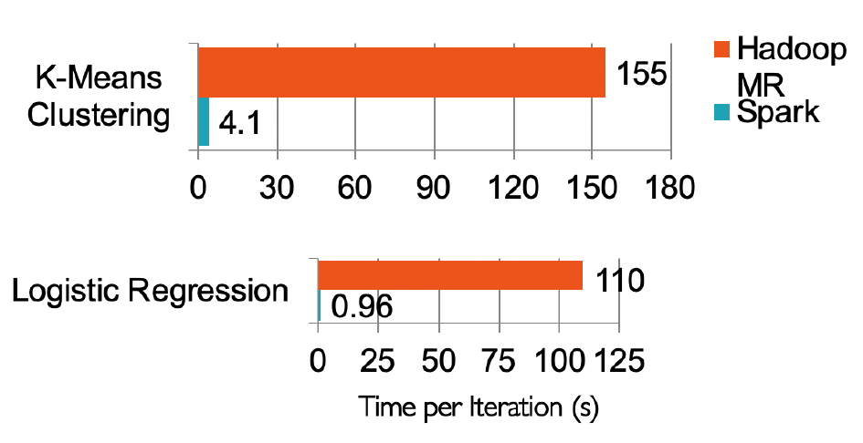
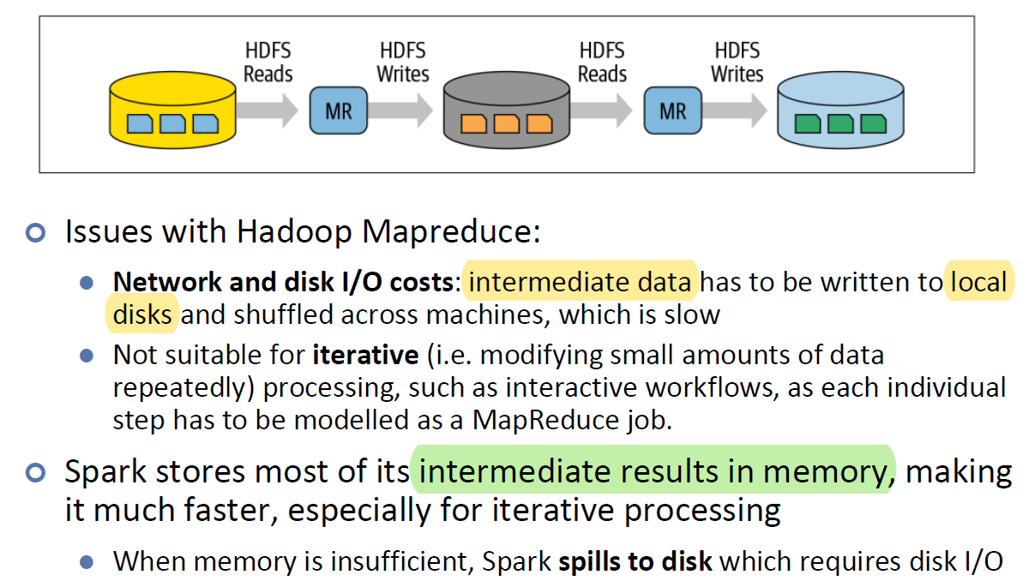
Question 1
Why Spark is more suitable for iterative processing compared to Hadoop?
Spark stores most of its intermediate results in memory, making it much faster, especially for iterative processing.
Lecture 6 - Slide 5
Lecture 6 - Slide 6

Slide 3
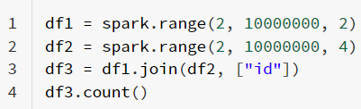
Question 2
In the below spark code block, please indicate which lines are transformation and which lines are action. For transformation, please also indicate whether it is a narrow transformation or wide transformation.

Slide 4
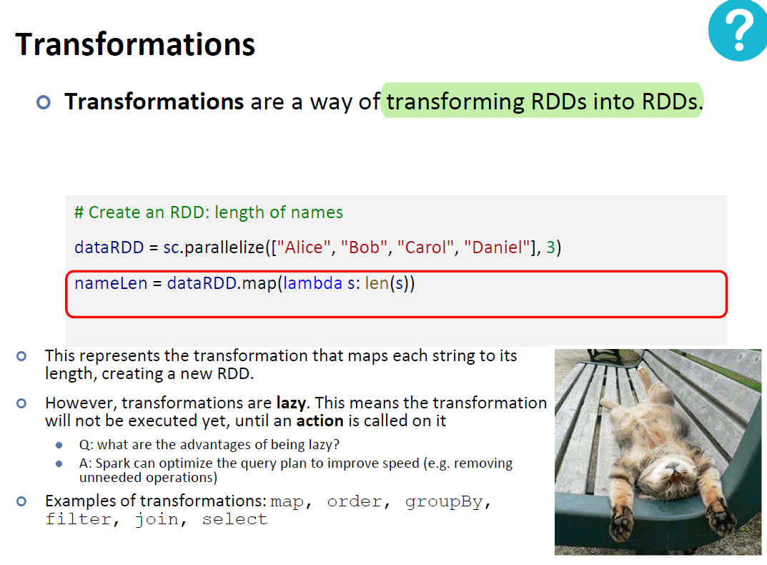
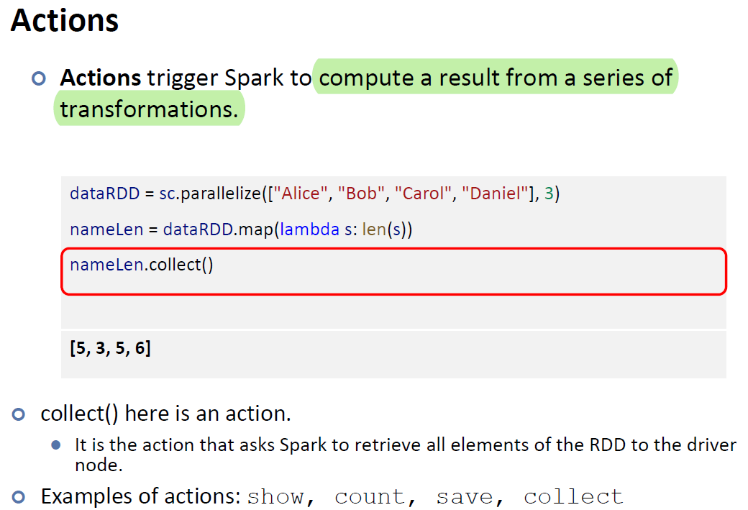
Lecture 6 - Slide 15
Lecture 6 - Slide 16

Slide 5
Question 2
In the below spark code block, please indicate which lines are transformation and which lines are action. For transformation, please also indicate whether it is a narrow transformation or wide transformation.
Line 1: Transformation
Line 2: Transformation
Line 3: Transformation
Line 4: Action

Slide 6
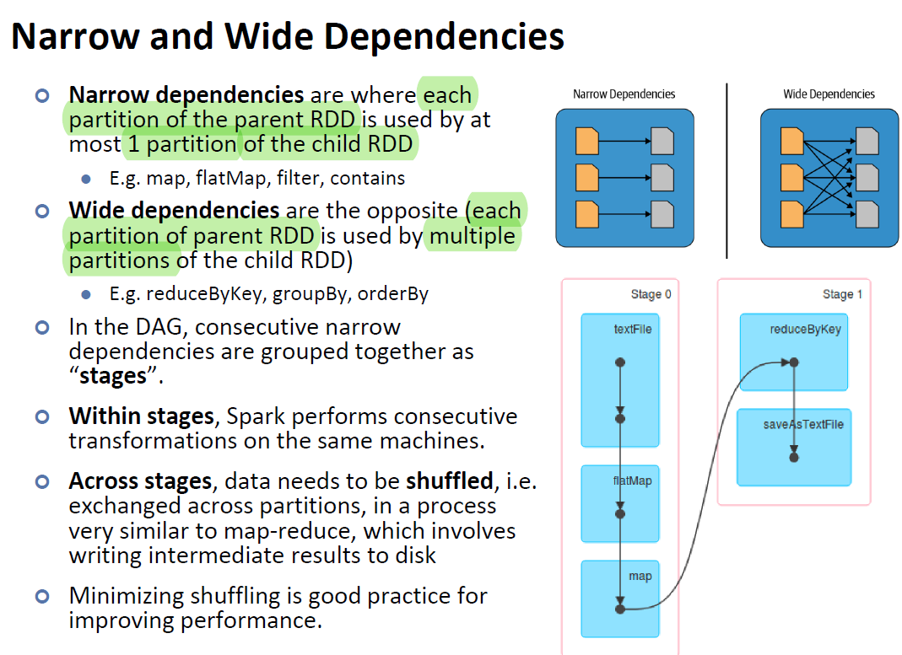
Lecture 6 - Slide 36

Slide 7
Question 2
In the below spark code block, please indicate which lines are transformation and which lines are action. For transformation, please also indicate whether it is a narrow transformation or wide transformation.
Line 1: Narrow Transformation
Line 2: Narrow Transformation
Line 3: Wide Transformation
Line 4: Action

Slide 8
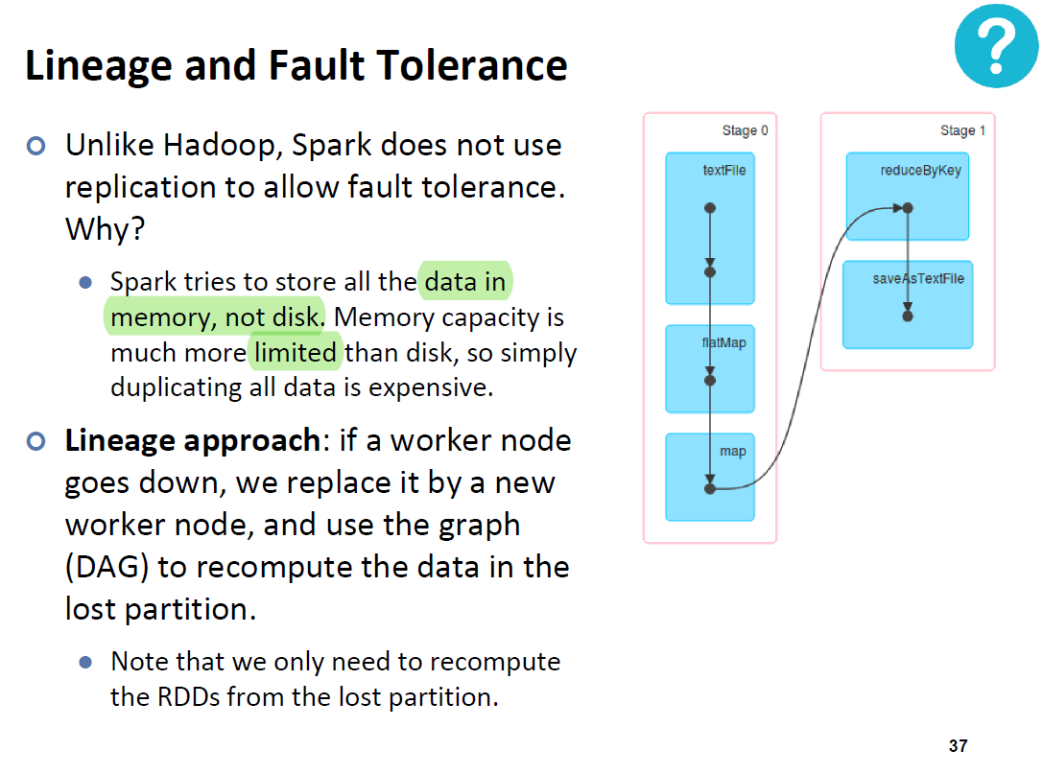
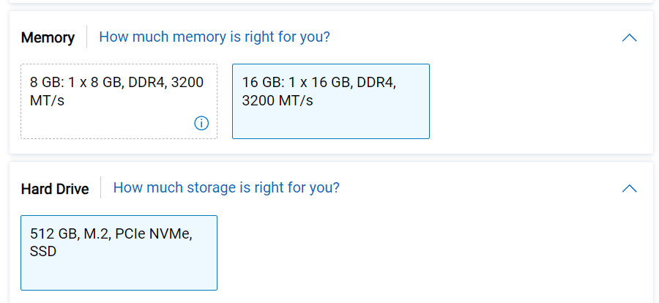
Question 3
In HDFS, each chunk is replicated for three times by default. In contrast, in Spark, RDD uses lineage for reliability. What is a major problem if Spark also uses replications for reliability?
Consumes a lot of memory; memory is much more scarce than disk space
Lecture 6 - Slide 37
Googled – Generic Specs of PC

Slide 9
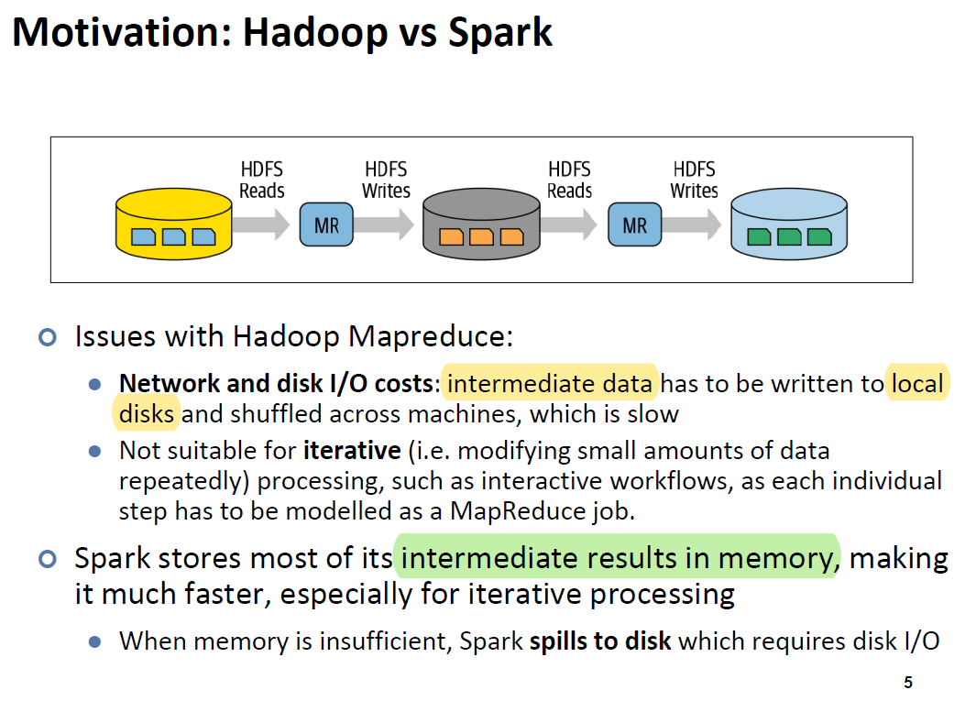
Question 4
Is it true that in the Spark runtime, RDD cannot reside in the hard disk?
False. RDD can also be in the disk if out of memory
Lecture 6 - Slide 5

Slide 10
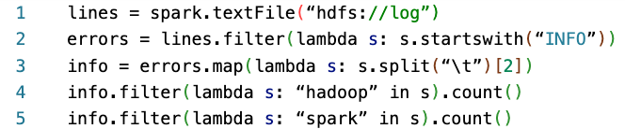
Question 5
Explain how the following program can be sped up.
Line 1: Reads a file from HDFS
Line 2: Filter to extract lines starting with “INFO”
Line 3: Split string by tab and extract 2nd component
Line 4: Count the number of lines with “hadoop”
Line 5: Count the number of lines with “spark”

Slide 11
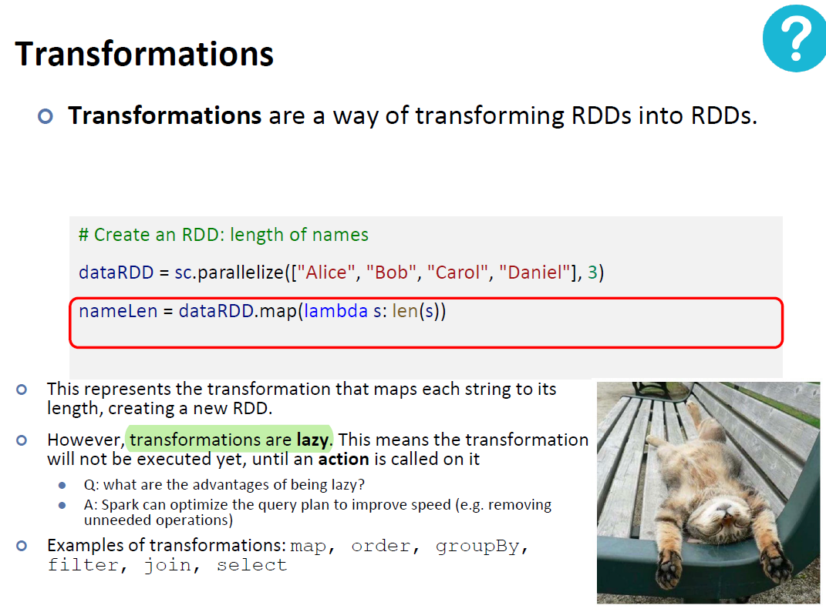
Lecture 6 - Slide 15

Slide 12
How to speed-up: we should add info.cache() (or info.persist()) before line 4, to cache the RDD in memory (or hard disk) so it doesn’t have to be re-computed in line 5.
info.cache()

